Slide 1


EFFICIENCY ANALYSIS OF LINEAR SEARCH: BEST, AVERAGE, AND WORST CASE
CSA0606-Design and Analysis of Algorithm
SLOT-B
Presented by
B Muni Chandini(192524283)
B.Tech AI&DS

Slide 2

Geo Tag Photo

Slide 3
INTRODUCTION
What is Searching?
Searching is the process of finding a specific element (the target) within a collection of data.
It is a fundamental operation in computer science, used in databases, file systems, and everyday applications.
Why Analyze Efficiency?
Not all searches are equal. The time taken depends on:
The size of the input (n).
The position of the target element.
Whether the target exists at all.
Focus of this Presentation:
We will analyze the Linear Search algorithm.
We will examine its performance in the Best, Average, and Worst cases using Asymptotic Notations (Big-O, Big-Θ, Big-Ω).

Slide 4
Problem Statement
The Problem:
Given an array arr [] of n elements and a target key x, find the index position of x in the array. If x is not present, return -1.
Input Conditions:
The array can be sorted or unsorted (Linear Search works on both).
The size n can be very large or very small.
The target x can be:
At the very beginning (Best Case).
Somewhere in the middle (Average Case).
At the very end or not present (Worst Case).
Goal:
To measure how the runtime scales as n grows under these three distinct input conditions.

Slide 5
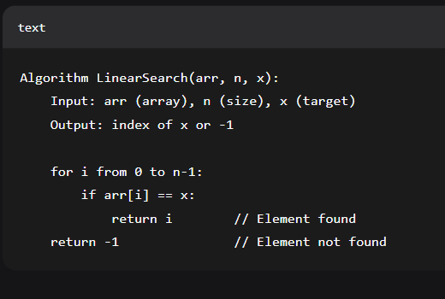
Algorithm / Pseudocode
Linear Search Algorithm:
Start from the leftmost element of the array.
Compare each element with the target x.
If a match is found, return the index.
If the end of the array is reached, return -1 (not found).
Pseudocode:

Slide 6
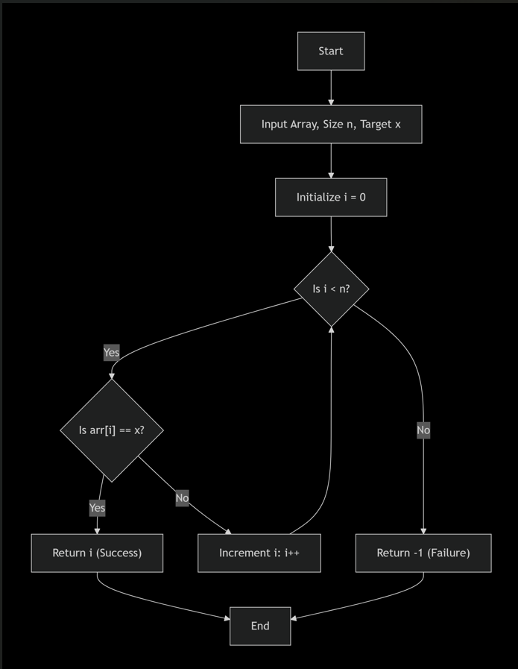
Architecture Diagram (Flowchart)

Slide 7
Implementation (Code)
def linear_search(arr, x):
"""
Performs Linear Search on an array.
Args:
arr: List of elements.
x: Target element to search.
Returns:
Index of x if found, else -1.
"""
for i in range(len(arr)):
if arr[i] == x:
return i
return -1
# Example Usage
my_list = [10, 23, 45, 70, 11, 15, 89]
target = 70
result = linear_search(my_list, target)
if result != -1:
print(f"Element {target} found at index {result}.")
else:
print(f"Element {target} not found in the list.")
Output:
Element 70 found at index 3.

Slide 8
Conclusion
Linear Search is simple but inefficient for large datasets.
Best Case (Ω(1)) is practically useless as a performance metric because it relies on luck.
Average Case (Θ(n)) is useful when dealing with random, unsorted data.
The Worst Case (O(n)) is the MOST SIGNIFICANT because:
It provides a guarantee on the maximum time required.
In real-world applications (e.g., checking for the absence of a record, like a username availability check), the algorithm must scan the entire list.
It allows us to make robust system design decisions

Slide 9
Thank you

